Slide 1
Youth Substance Use
DATA 5322: Statistical Machine Learning II
Njenga Gakwa
Notes:
Hello everyone, In this presentation we will be exploring youth substance use. From the DATA 5322. My name is Njenga Gakwa

Slide 2
Introduction
Domain Problem
Project Overview

Slide 3
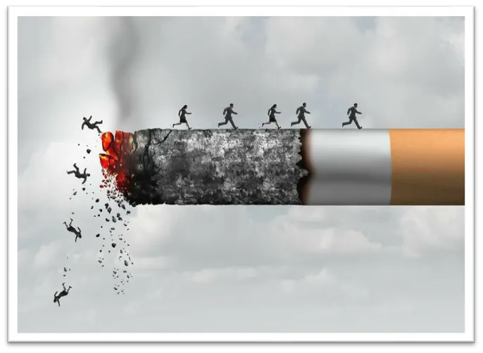
Domain Problem
Research Question:
How do demographic and household factors influence substance use and its frequency in the youth under 18?
Focus on:
Alcohol use (binary)
Marijuana use (multi-class)
Cigarette use frequency (regression)
Notes:
The Professional Women’s Hockey League generates a large amount of detailed game-event data including shots, goals, penalties, assists, and player information.
However, analyzing this type of data requires a structured relational database that organizes events, players, teams, and games into connected tables.
Our project addresses this challenge by designing a database that models PWHL hockey data in a way that supports structured analytics.

Slide 4
Data Overview
Source: National Survey on Drug Use and Health
~10,000 observations and 79 variables
13 demographic variables:
sex
race
Income
Poverty level
parental presence
geographic factors
school grade
Notes:
The project sits at the intersection of sports analytics, data management, and relational database systems.
The database was designed to capture the relationships between players, teams, games, and in-game events such as shots, goals, assists, and penalties. The key entities are listed on the screen.
…. By structuring the data in this way, we can meet our main objective of being able to use SQL to explore hockey analytics through queries related to player performance, team composition, and game outcomes.

Slide 5

Data Cleaning
Data conversion
Missing values

Slide 6
Modeling Approach
Acts as the baseline
Greedy Approach
Similar to Decision Tree but limits predictors
Decision tree
Pruned Decision tree
Bagging
Random Forest
Using cross validation
Similar to bagging but utilizes a subset of predictors
Notes:
Here you can see the timeline of our project development and a brief overview of the methodology behind our analysis.
We began with an initial analysis, where we explored available PWHL data sources and identified the key entities needed to model hockey game data.
Next, during the preparation phase, we designed an entity–relationship diagram and translated it into a normalized relational schema implemented in SQLite.
In the analysis stage, we wrote SQL queries using multi-table JOINs and subqueries to generate a shot-level dataset that connects game events, players, and teams.
We then expanded the project by cleaning and transforming the data using Python and pandas. We also built an ETL pipeline that integrates additional player statistics from the HockeyTech API.
Finally, we optimized query performance using indexing and completed our final analysis and presentation of the results.

Slide 7


Decision Tree Plot
Grade_level: 1,2,3,4,5
Grade_level: 1,2,3
Notes:
Now for Tools and Technologies – we used several tools across the data pipeline.
SQLite served as the relational database where we implemented our schema and stored the hockey data.
For analysis and data processing we used Python, specifically pandas within a Jupyter Notebook environment. This allowed us to load SQL query results directly into DataFrames for cleaning and transformation.
Finally, SQL was used extensively for relational querying, including the multi-table JOINs, nested subqueries, and query optimization techniques (like indexing).
Please feel free to view our github at the link provided on the screen. This is where our documentation will be permanently stored.

Slide 8
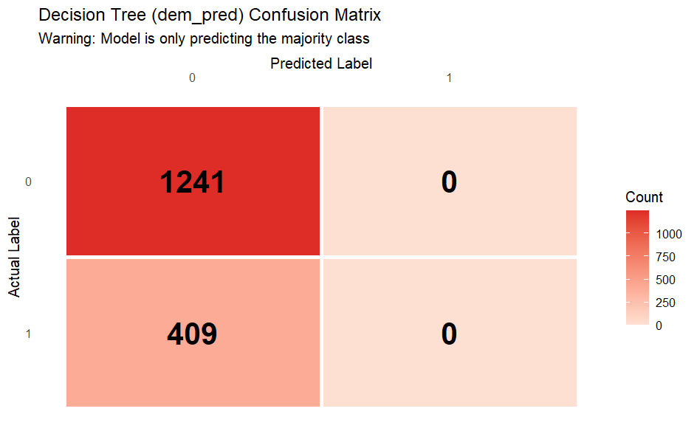
Model Evaluation and interpretation

Slide 9
Bagging
Random Forest
Uses all predictors
Reduces Variance
Uses subset of predictors
Reduces correlation between trees
Better Performance

Slide 10
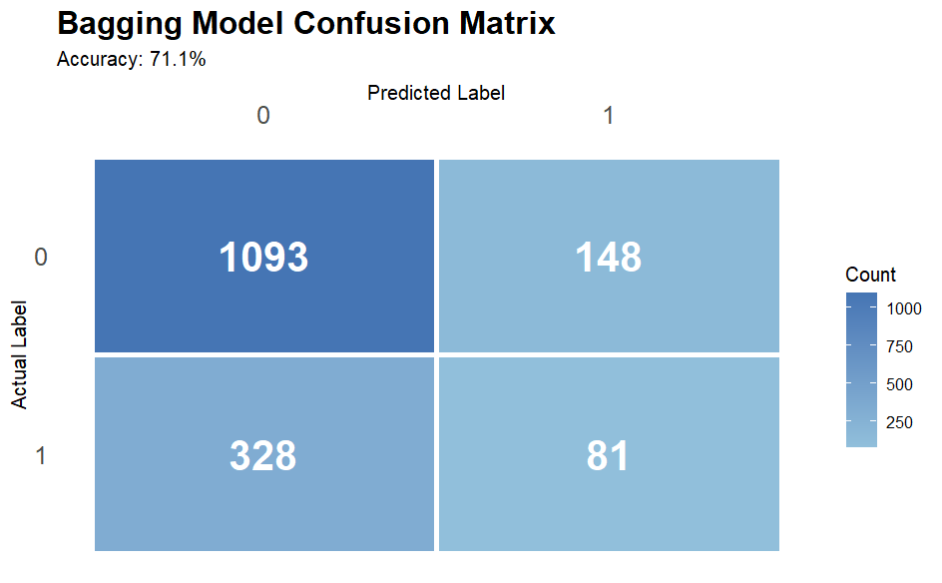
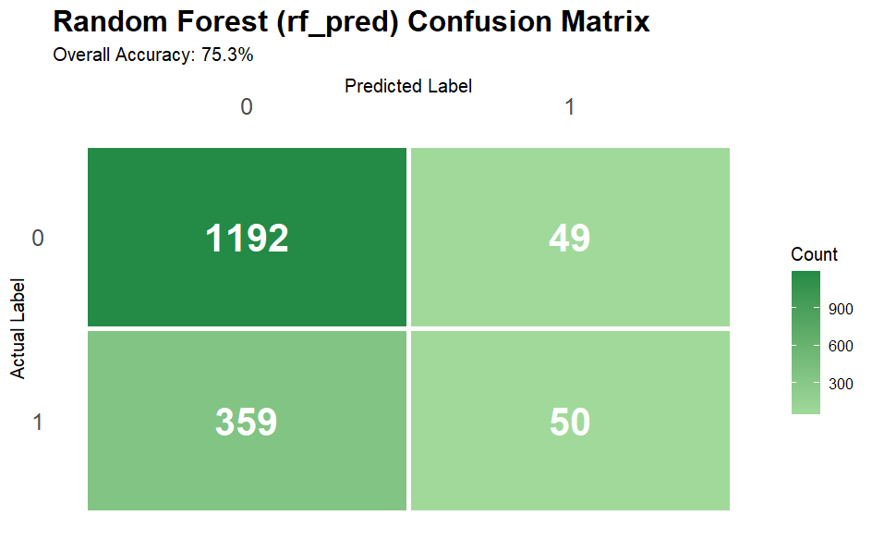
Performance Comparison

Slide 11
Variable Importance
Most Important Predictors:
Grade level
Income
Poverty Level
Less Important:
Parental Presence
Geographical variables

Slide 12
Ethical Considerations
Results show correlation, not causation
Demographics ≠ behavior
Avoid Stereotyping
Reflect broader social context

Slide 13
Conclusion
Grade level is the strongest predictor
Substance use increases with age
Demographics alone are limited
Random Forest improves performance

Slide 14
Thank You!

